Slide 1
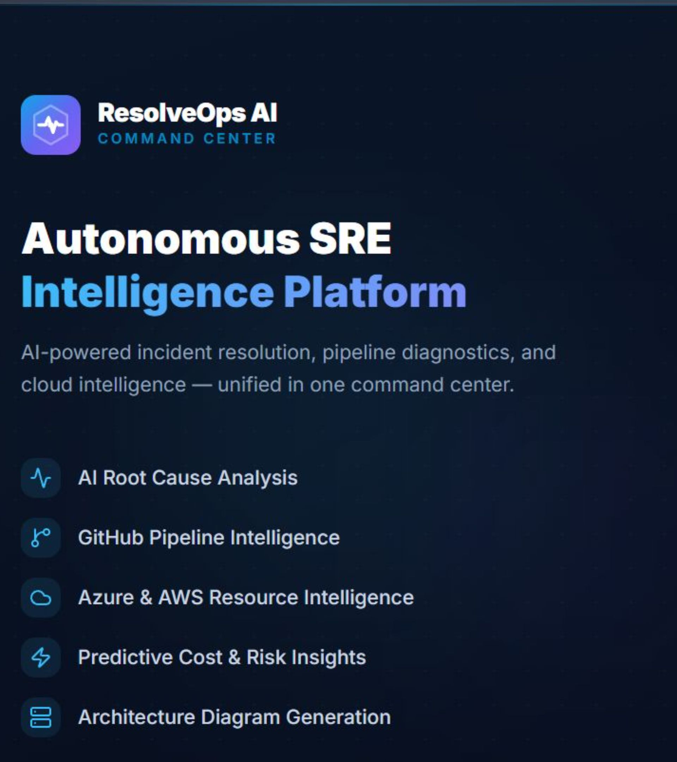
ResolveOps AI
An AI-powered cloud incident investigation platform — built in 7 months while learning DevOps from scratch

Slide 2
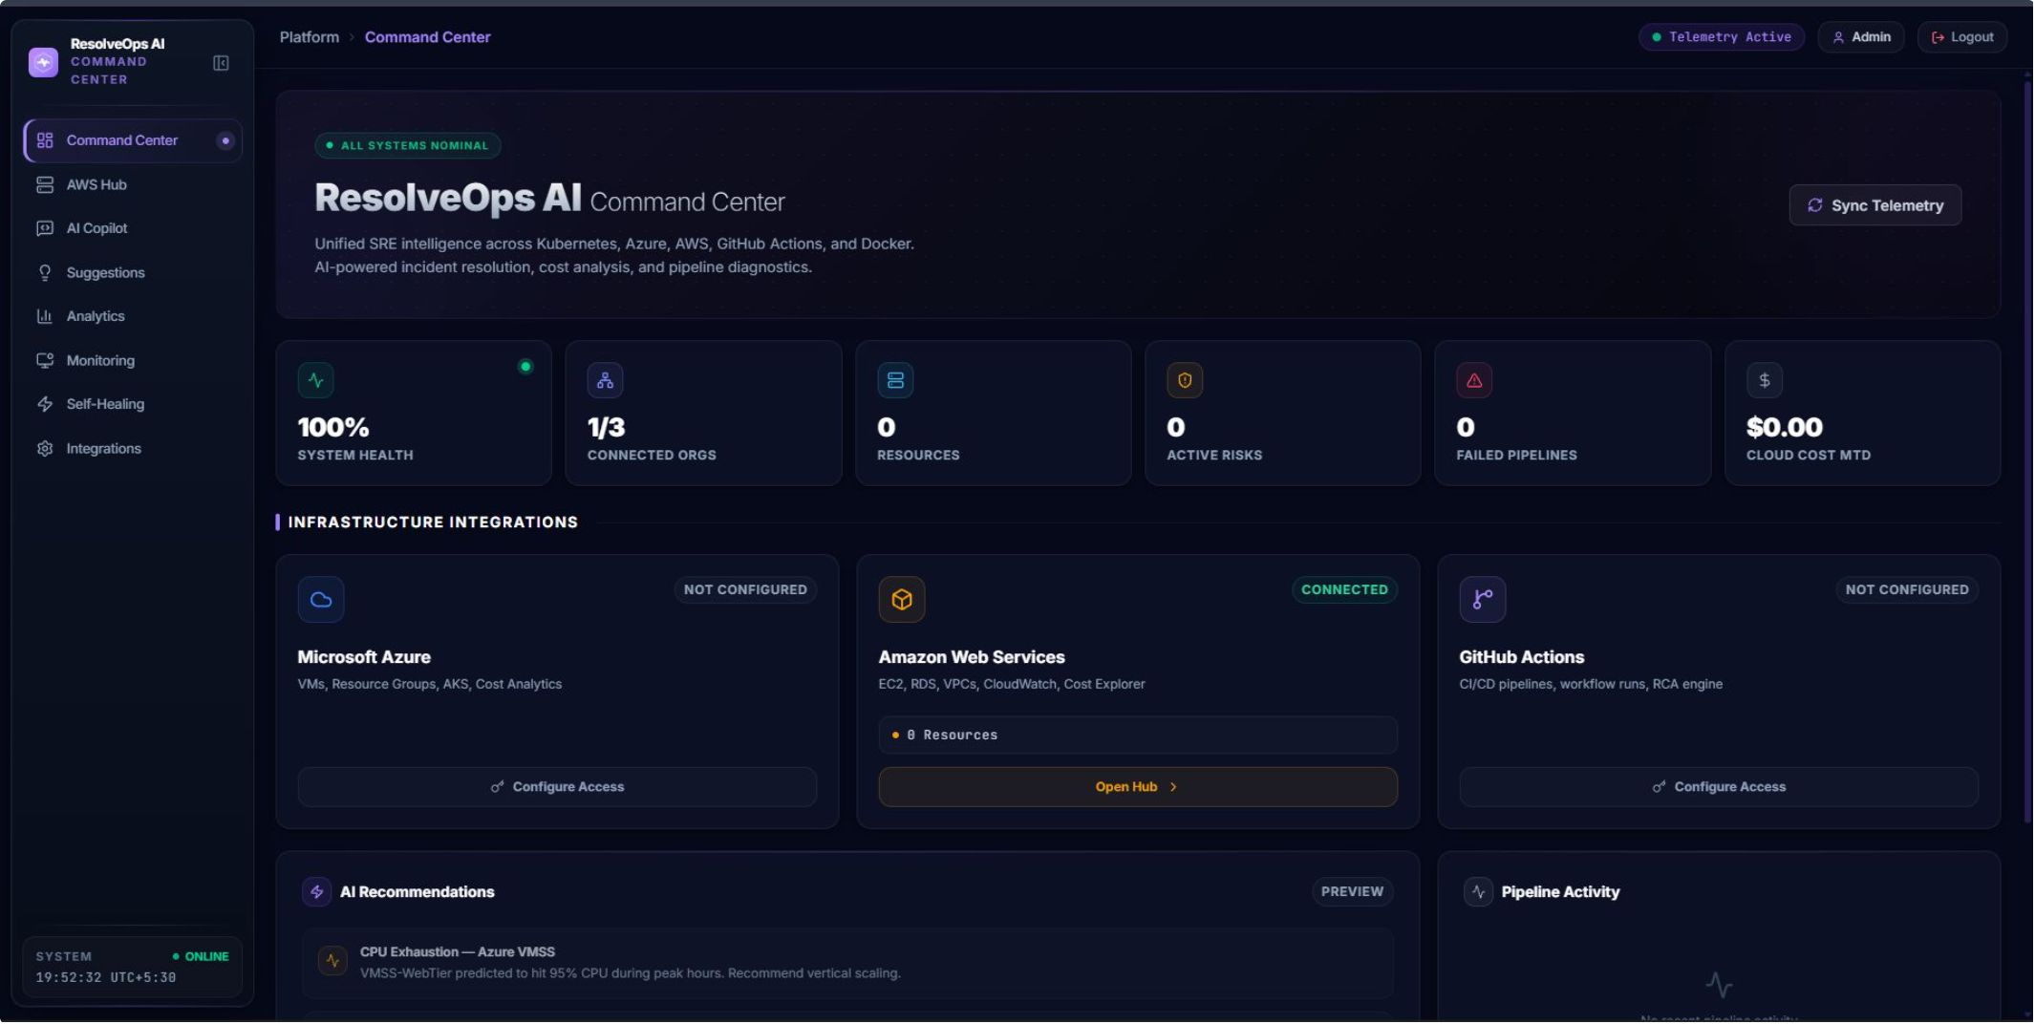
The Problem I Noticed
Production checkout service fails at 3:47 AM. The on-call engineer snaps awake and opens:
30–90 minutes just to find the root cause
Different engineers check different things — no consistent process
AI chatbots give generic answers — they don't know YOUR infrastructure
CloudWatch
GitHub
Docker
AWS Console
Slack

Slide 3
What Is ResolveOps AI?
Single Interface
Real Evidence First
One place to investigate any cloud incident — no tab-switching, no context loss
Collects live data from AWS, Azure, GitHub, and Docker before any AI reasoning begins
Structured RCA Output
100% Read-Only
AI produces a Root Cause Analysis with citations, confidence score, and recommendations
Never changes your infrastructure automatically — investigates only, never acts

Slide 4
How It Works (Simple Version)
1
You Ask
"Why is my checkout service failing?"
2
It Collects
CloudWatch metrics, GitHub deployments, Docker restarts, AWS resource state
3
AI Reads Evidence
"High probability — deployment at 3:39 AM changed a config variable"
4
You Get
Summary, probable cause, confidence score, cited evidence, and recommendations

Slide 5
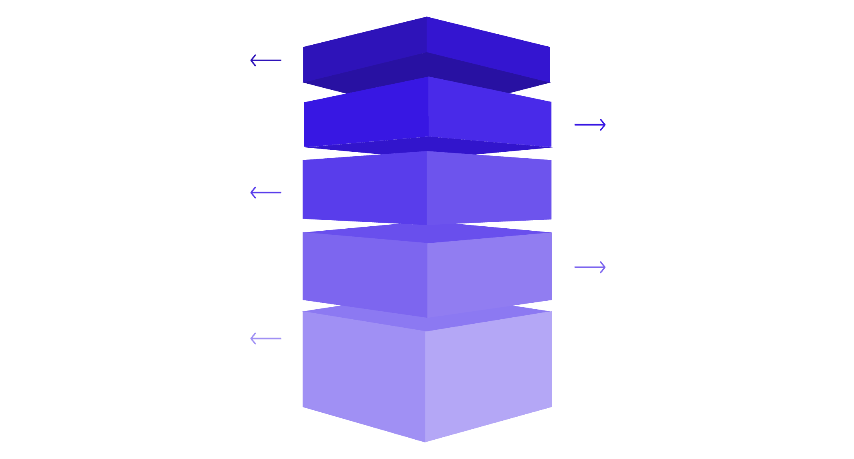
System Architecture
Infrastructure at a Glance
13 Docker containers orchestrated via Docker Compose
All services on isolated Docker networks
PostgreSQL for persistence
Named volumes for database data and generated visual artifacts
Caddy handles HTTPS termination automatically
Edge Layer
User to Next.js frontend via Caddy HTTPS.
Gateway Layer
API Gateway routes requests to AI-RCA service.
Processing Layer
AI-RCA forwards to MCP server for orchestration.
Intelligence Layer
AWS, Azure, GitHub, Docker evidence integrations.
Persistence Layer
PostgreSQL on isolated Docker networks with volumes.

Slide 6
CORE INNOVATION
Model Context Protocol (MCP)
MCP is an open standard from Anthropic for AI-to-tool communication. Instead of AI guessing — AI requests specific tools to fetch real data.
My MCP server exposes: AWS tools, Docker tools, GitHub tools
AI model calls a tool → gets real data → reasons from actual evidence
Every tool call is logged: what was asked, what came back, how long it took

Slide 7

Evidence Collection — Concurrent & Fault-Tolerant
⚡ Concurrent by Design
🛡️ Fault-Tolerant
AWS CloudWatch queried at the same time as GitHub and Docker — no waiting in line
If one source fails — the others still work and return evidence. No single point of failure
⚠️ Transparent Warnings
🧩 Partial Evidence Wins
Each source failure is recorded and shown as a warning to the user — no silent failures
Partial evidence is better than waiting for everything or blocking the whole investigation
"This was one of the hardest engineering problems I solved"

Slide 8
The RCA Investigation Flow
01
02
03
Operator asks
Types incident question in the frontend
Auth + IDs
API Gateway authenticates via JWT → AI-RCA service creates Request ID + Investigation ID
Tool Selection
AI model sees available MCP tools and selects which ones to call
04
05
Evidence Collection
MCP server executes tools against real services — source, resource, timestamp, citation captured
RCA Delivered
AI correlates evidence → structured JSON: summary, probable cause, confidence, impact, recommendations
Frontend displays result with warnings for any unavailable evidence sources — full transparency at every step.

Slide 9
AWS Intelligence — What Gets Pulled
EC2
CloudWatch
S3
EKS
Instance state, type, AZ, EBS volumes, ENIs, security groups
CPU, memory, network metrics, custom metric alarms
Bucket security posture, lifecycle rules, object summary
Cluster state, node groups, Kubernetes workloads
CloudTrail
RDS
Lambda
Cost Explorer
API call history, IAM events, configuration changes
Database health, snapshots, parameter groups
Function state, event sources, configuration
Month-to-date billing, on-demand catalog rates

Slide 10
Why Evidence-First Matters
The Problem with Raw AI
The ResolveOps Solution
Cited Conclusions Only
LLMs hallucinate — they make up resource IDs, workflow names, instance states. Ask "why is my service down?" without data → generic, made-up answer
Collect evidence first → pass evidence to AI → AI reasons only from it. System prompts explicitly say: "Do not invent resource names or workflow IDs"
Every conclusion in the RCA is tied to a specific cited evidence item — no floating claims, no hallucinated infrastructure

Slide 11
Why Evidence-First Matters — The AI Safety Problem
AI without evidence
The Problem with Raw AI
Hallucinates, makes things up, and sounds confident while inventing details.
LLMs hallucinate — they invent resource IDs, instance names, workflow details
Ask "why is my service down?" without data → generic, made-up answer
Sounds confident but is completely unreliable
Evidence flowing in
Real signals from AWS, Azure, GitHub, and Docker are collected before analysis.
The ResolveOps Solution
Collect real evidence first (AWS, Azure, GitHub, Docker)
Pass evidence to AI → AI reasons ONLY from what was collected
System prompts explicitly block: "Do not invent resource names, workflow IDs, or ARNs"
AI with evidence
Grounded conclusions flow out, with cited facts and transparent reasoning.
The Result
Every conclusion is tied to a specific cited evidence item with source and timestamp
Trustworthy, grounded analysis instead of confident-sounding guesses
Full transparency — user sees what evidence was used

Slide 12
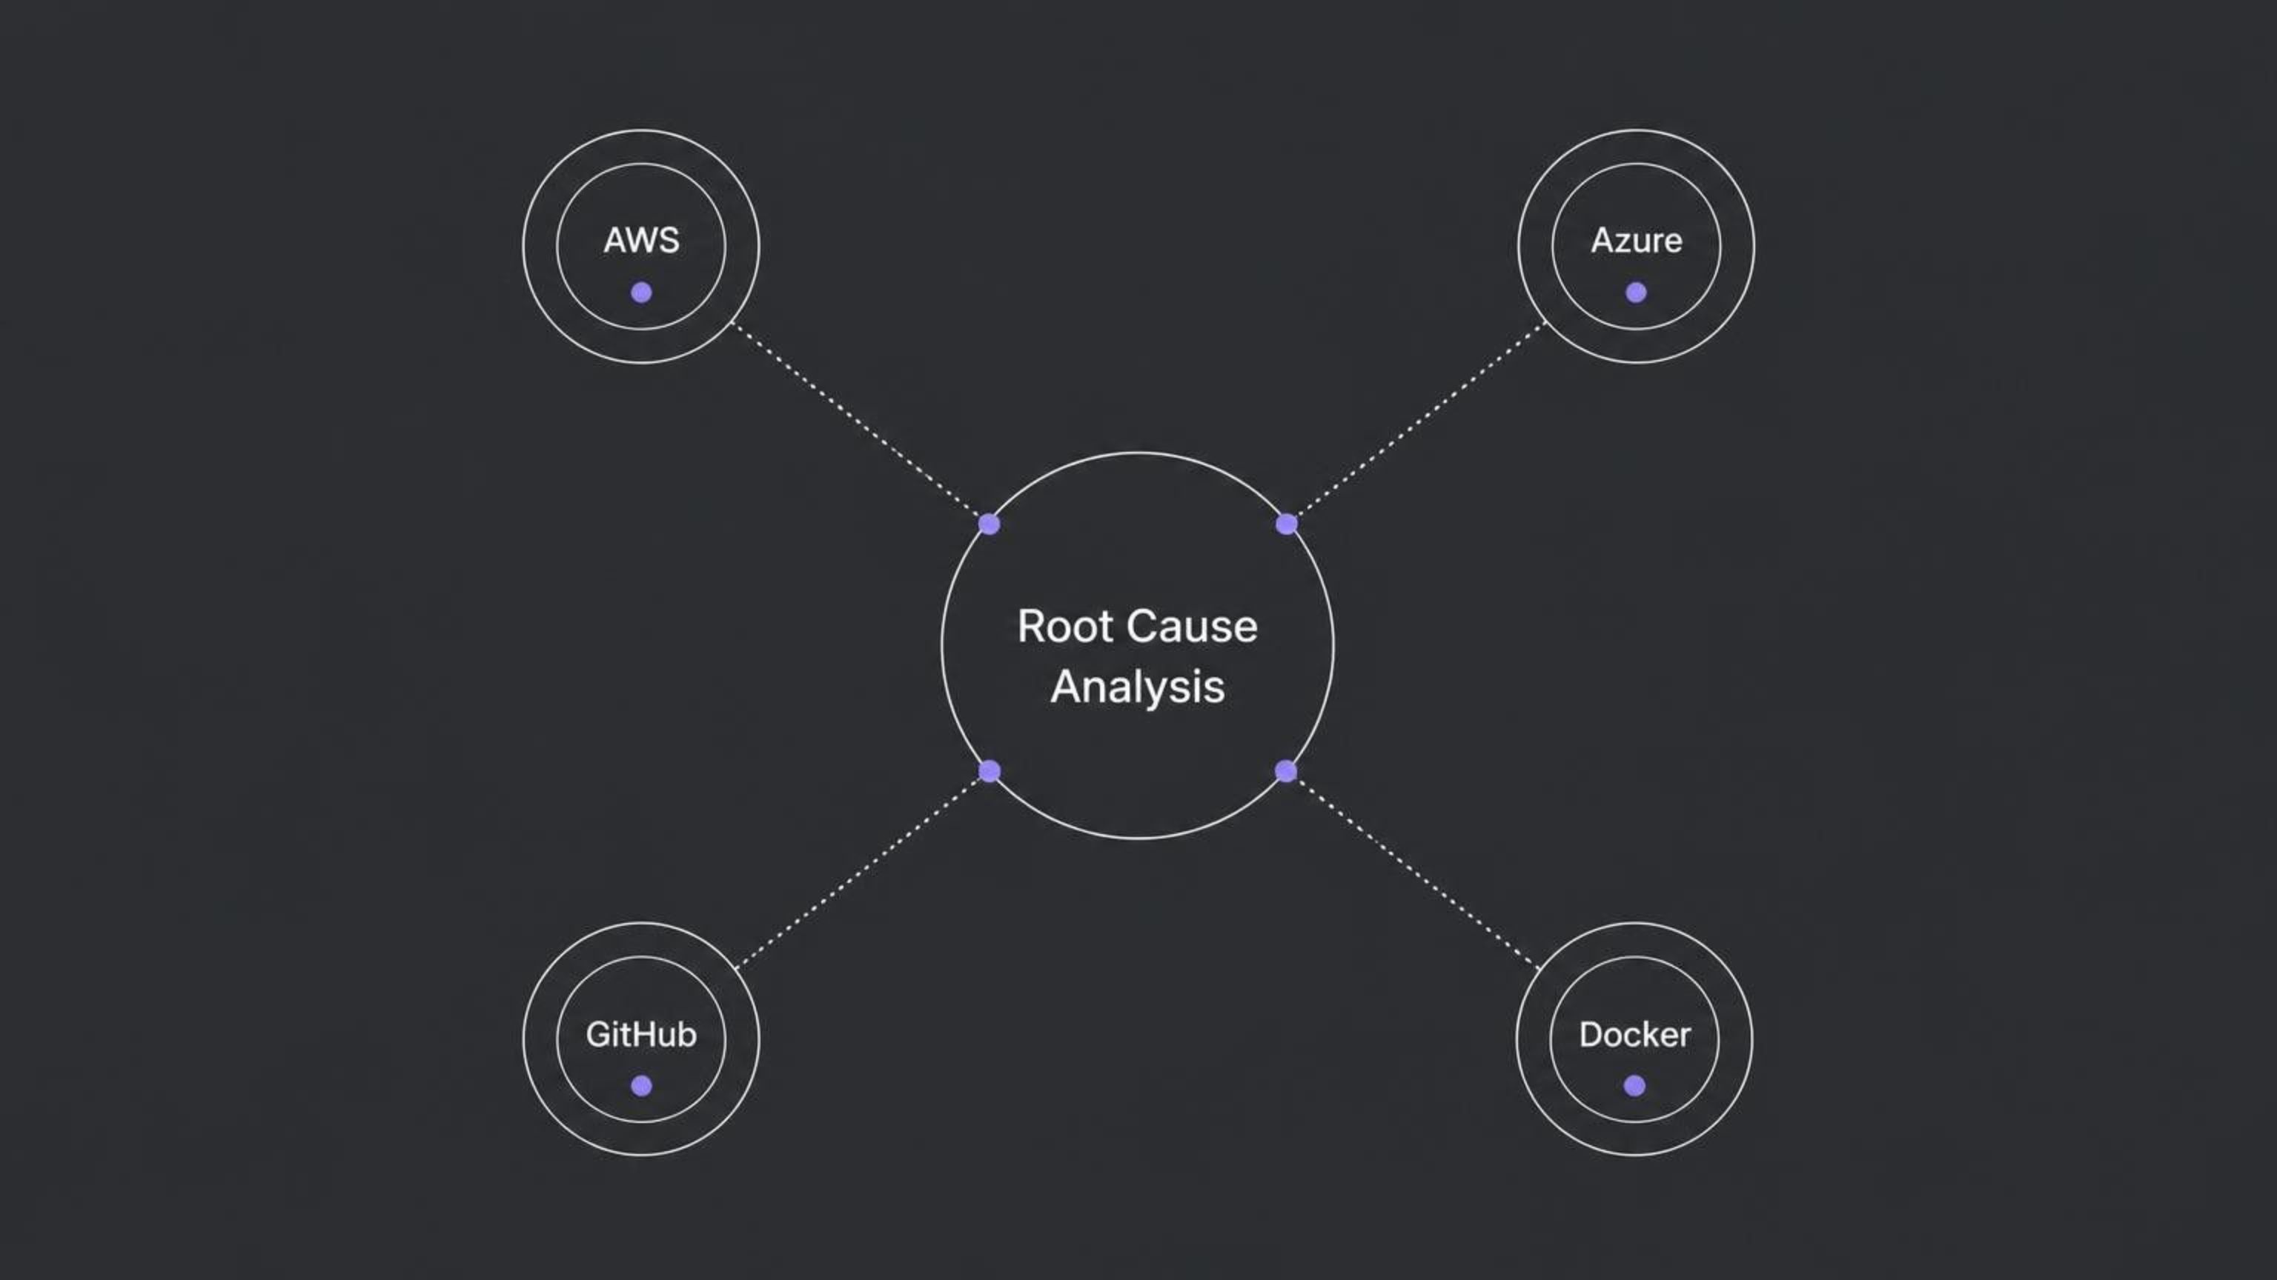
Multi-Cloud + Multi-Source Intelligence
AWS
Azure
GitHub
Docker
EC2, RDS, EKS, Lambda
CloudWatch, CloudTrail, S3
EBS volumes, Elastic IPs
Cost Explorer
Azure Monitor
Resource health
AKS cluster visibility
Commits
Pull requests
GitHub Actions deployment events
Correlated with incident timeline
Container state
Logs
Resource usage
Restart counts (read-only socket)
All four sources queried concurrently — no waiting
If one source fails, the others still return evidence (fault-tolerant design)
All evidence correlated into a single unified Root Cause Analysis response

Slide 13


Security Design — How I Built It Safely
JWT authentication: every API request is verified with a signed token before processing
AWS credentials from environment variables only — never hardcoded in source code
Docker socket mounted read-only: the adapter can observe containers but cannot change them
Investigation path is 100% read-only: no automatic restart, delete, scale, or config changes
AI prompts explicitly block any infrastructure-changing recommendations
Internal services communicate on isolated Docker backend networks — not exposed to public
Every request has a unique traceable Request ID and Investigation ID for accountability
READ-ONLY BY DESIGN
ISOLATED NETWORKS
TRACEABLE IDS
"Security was something I had to figure out as I went. Learning about IAM permissions alone took me several days of debugging."

Slide 14
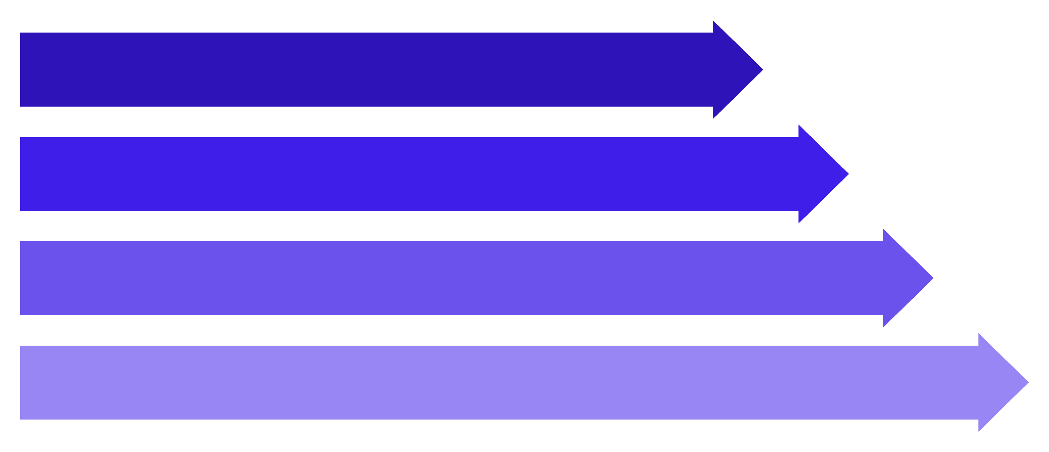
Visual Intelligence — More Than Just Text
Every response is routed to the right format automatically
User Question
Intent Classifier
Route to Format
Text/Table/Chart/Image
Intent Classifier Routes Every Response
What You Get
Plain text (for explanations)
Data table (for structured data)
CloudWatch metrics rendered as real-time interactive charts (CPU spikes, memory trends)
Architecture questions generate visual diagrams of infrastructure and service dependencies
Line/area chart (for metrics over time)
Mermaid diagram (for architecture/flows)
AI-generated visual specs → structured interactive diagrams or PNG images
Every visual response always paired with a plain-text technical explanation
Generated image (for visual specs)
Fallback design: if image generation fails → falls back to structured diagram
Example: Ask 'Show me the architecture of my checkout service' → get a full architecture diagram

Slide 15

LEARNING JOURNEY
What I Learned Building This
Docker
AWS SDK (boto3)
Multi-container orchestration, health checks, named volumes, and network isolation between services.
Writing real API calls to EC2, CloudWatch, RDS, S3, Lambda, and Cost Explorer.
Python FastAPI
Next.js
Building 10 production-style microservices from scratch.
Building a full production-grade frontend with dynamic routing and API integration.
Model Context Protocol (MCP)
Prompt Engineering
A brand-new Anthropic open standard I had never heard of before starting.
How to prevent AI hallucinations by structuring system prompts carefully.
Security Thinking
Failure Thinking
Credentials, IAM permissions, read-only boundaries, and JWT auth.
Designing what happens when one service crashes without breaking everything else.
"I started this when I didn't know what Docker Compose was. Every single one of these was a new concept at some point during the build."

Slide 16
The Hardest Challenges I Faced
1
2
3
Challenge 1: Getting 13 Docker services to start in the correct order
Challenge 2: AWS IAM permissions — understanding what each service needs access to
Challenge 3: Preventing AI hallucinations — AI kept making up resource names
A complex orchestration problem where services have interdependencies, leading to startup failures and instability if not managed properly.
Solution: Implemented Docker health checks for each service. This ensures a service waits for its dependencies to be fully healthy and operational before it attempts to start, creating a robust and orderly startup sequence.
Combating the tendency of Large Language Models (LLMs) to confidently generate non-existent information or details when not properly constrained by real data.
Solution: Employed extensive prompt engineering techniques. Explicitly forbade the AI from inventing identifiers and mandated the inclusion of evidence citations for every piece of information in its responses, grounding its output in fact.
Navigating the intricate world of AWS Identity and Access Management to assign precise permissions, avoiding both over-privileging and under-privileging resources.
Solution: Dedicated significant time to reading AWS documentation and conducting individual tests for each permission. Adopted the principle of least privilege, granting only the necessary access for each service to function.
4
5
Challenge 4: Concurrent evidence collection — querying 4 sources at once without mixing results
Challenge 5: Building a frontend that looks production-grade
The challenge of designing and implementing a user interface that is not only functional but also visually appealing, intuitive, and polished enough to meet professional product standards.
Solution: Conducted thorough research by studying modern DevOps dashboards for best practices. Incorporated design elements like glassmorphism and a cohesive dark theme, coupled with robust real data bindings for dynamic content.
The complexity of simultaneously querying multiple disparate data sources (AWS, Azure, GitHub, Docker) and ensuring their distinct results are accurately aggregated without cross-contamination or data integrity issues.
Solution: Each source call was isolated using Python asynchronous patterns. Furthermore, each call was wrapped in independent error handling mechanisms, guaranteeing robust and separate data collection.

Slide 17
Technology Stack
Built with modern, production-grade tools
Frontend
Backend
Next.js 14, React, JavaScript
Python 3.11, FastAPI-style HTTP services (10 services)
AI Providers
Protocol
Groq (LLaMA 3.1 free tier), Amazon Bedrock, OpenAI
Model Context Protocol (MCP) — Anthropic open standard
Database
Deployment
PostgreSQL 15 Alpine
Docker Compose (13 containers), AWS EC2 t3.large
Edge
Notifications
Caddy HTTPS reverse proxy
Slack webhook, SMTP email, PagerDuty

Slide 18
What's Next + Thank You
Future Roadmap
Kubernetes (Helm chart)
Moving from Docker Compose to production-grade orchestration
Real-time streaming RCA
Live incident investigation as events happen
I built this in 7 months while learning DevOps. Every service was a new concept. Every bug was a lesson. The goal was simple — solve a real problem and actually ship something.
Mobile dashboard
Investigate incidents on the go
Governed remediation
AI-suggested fixes with human approval gates
Call to Action
Demo: http://localhost:3000
GitHub: [your repo link]

